Slide 1
Teaching Responsibility: Pedagogical Strategies for Eliciting a Sense of Moral Responsibility
William J. Frey
Professor of Business Ethics
College of Business Administration
University of Puerto Rico at Mayaguez

Slide 2
Agenda
Hasting Center’s objectives
Moral Responsibility
Negative and Positive
As a virtue
Metaphorically Structured
Root meaning: response to relevance
Learning Activities:
Techno-Socio Responsiveness,
Responsible Choice in Appropriate Technology
Forums: Job Fair and Appropriate Technology

Slide 3
Teaching the Hastings Center Objectives
Stimulate the moral imagination of students
Help students recognize moral issues
Help students analyze key moral concepts and principles
Elicit from students a sense of responsibility
Help students to accept the likelihood of ambiguity and disagreement on moral matters, while at the same time attempting to strive for clarity and agreement insofar as it is reasonably attainable
Michael Pritchard. Reasonable Children: moral education and moral learning. University of Kansas Press, 1996: 15

Slide 4
Rodney King Argument
“Why can’t we all just get along.”
Positive conception of responsibility is unrealistic, vague, and sounds fishy
Responsibility needs teeth
responsibility and punishment are necessarily connected
The moral sense is reducible to the legal sense

Slide 5
Negative Responsibility
Negative Responsibility: “What is really true for the ordinary moral consciousness…is the necessary connexion between responsibility and liability to punishment, between punishment and desert, or the finding of guiltiness before the law of the moral tribunal. For practical purposes we need make no distinction between responsibility, or accountability, and liability to punishment. Where you have the one, there…you have the other….” 4-5
Moral Tribunal: “the idea of a man’s appearing to answer. He answers for what he has done, or (which we need not separately consider) has neglected and left undone. And the tribunal is a moral tribunal; it is the court of conscience, imagined as a judge, divine or human, external or internal.” 3

Slide 6
Ladd: Positive Responsibility
“Substituting moral deficiency for fault makes it possible to cut the tie between responsibility and blame….”
“In contrast to fault, which in all of its ramifications and connotations suggests a positive evil for which blame may be the appropriate response…, moral deficiency calls our attention to a privation, something missing that ought to be there.”
John Ladd, “Bhopal: An Essay on Moral Responsibility and Civic Virtue.” Journal of Social Responsibility 22(1), March 1991: 88

Slide 7
Responsibility as a Virtue
“I consider responsibility to be a virtue, because, like other virtues, it is other-regarding, it is intrinsically motivational and it binds persons to each other.”
Responsibility as a virtue is oriented toward moral excellence (=arete), not just rock bottom duties
moral saints and moral heroes
but also fairly ordinary people who bring about “good works”
Ladd, “Bhopal: An Essay on Moral Responsibility and Civic Virtue,” 89.

Slide 8
Moral Responsibility is metaphorically structured
Its root meaning is response to relevance
Root meaning is projected onto different “abstract moral domains”…
producing a metaphorical expansion of the root meaning that encompasses many different senses of responsibility including the positive and negative
Nicole Vincent, Ibo van de Poel, Jeroen van den Hoven, eds. Beyond Free Will and Determinism. Springer, 2011.

Slide 9
Fingarette poses the “root meaning”
“It is this responsiveness to essential relevance which, in the last analysis, constitutes the root notion, though not the entire meaning, in the concept of responsibility.”
Responsiveness to essential relevance…
bridges gap between cognitive and volitional tests for criminal insanity
illuminates moral as well as legal responsibility
Moral responsibility can be unpacked as (moral) response to essential (moral) relevance.
Fingarette, H. The Meaning of Criminal Insanity. University of California Press, 1971: 186-7.

Slide 10
Root meaning is extended through metaphorical projection
Johnson
Metaphor = “process by which we understand and structure one domain of experience in terms of another domain of a different kind”
Elements of metaphorical projection
Source domain = Image schema (physical force and physical force and interactions or stimulus-response
Target domain = abstract moral space
Image schema “recruited” from sensorimotor experience to structure to the target domain (abstract moral space) (See Johnson quote on next page.)
Johnson, M. The Body in the Mind: The Bodily Basis of Meaning, Imagination, and Reason. University of Chicago Press, 1986: 13-16.

Slide 11
Image Schema comes from bodily experience of “physical force and interactions”
Physical basis of moral responsibility…
“image schemas are…structures of sensorimotor experience that can be recruited for abstract conceptualization and reasoning” (Johnson 2007: 141)
Projection of image schema onto moral domain
“ Step-by-step, I begin to acquire the notion of responsibility that is not tied to reflex response alone. I discover that I can sometimes respond to a physical stimulus by means of a self-initiated, purposive action, which I come to experience as very different from mere automatic, or “knee-jerk,” reflex reactions” (Johnson, 1986. )
Johnson, M. The Meaning of the Body: Aesthetics of Human Understanding. University of Chicago Press, 2007: 176-179

Slide 12
Image schema: Physical stimulus “evokes” a reflex response (Built upon Johnson, BIM)
Metaphor: Image schema (= source domain) is projected onto the abstract moral realm (=target domain)
Stimulus /
Response
Perception of
Moral relevance-
Responsive action
Source domain (physical force and interactions) has “internal structures
that give rise to constrained inferences” in target domain
(abstract moral realm) (Johnson, MB, 144)

Slide 13
Mappings: From the negative to the positive
Case | Uncovering moral salience (identifying relevance) | Responding to moral salience (response to relevance)
CIAPR disciplinary tribunal | Perception of circumstances that trigger rule relevance | Compliance with rule
Permits for Windmill Farm | Perception of social injustice | Opposition to restore justice
Laminating Press Room | Perception that powder may be harmful (active questioning) | Investigate; Design safety measures; Monitor to detect effects of past exposure
Generating Good Will | Perception of difficulties undergone by family without generator | Sharing electricity with family
Borenstein | Perception that embedded training program could cause an accidental missile launch | Re-configure pacifism to permit collaboration with NATO on safer training program

Slide 14
This table provides…
Examples that display the root metaphor, response-to-relevance
Root metaphor is elaborated in different ways as it is projected onto different moral regions or “spaces”
Response-to-relevance links positive and negative senses
From blame-centered to supererogatory

Slide 15
Modules for teaching “response to relevance”
Techno-Socio Responsiveness
Responsible Choice in Appropriate Technology
Forums: Job Fair and Appropriate Technology

Slide 16



GREAT IDEA Graduate Research and Education for Appropriate Technology: Inspiring Direct Engagement and Agency NSF #1033028 www.greatidea.uprm.edu
SEAC
Saturday October 5, 2013 Corvalis, Oregon

Slide 17
Socio-Technical System Analysis
Responsibility Skill | Description | Module | Activities
Techno-socio sensitivity Socio-Technical Systems in Professional Decision Making (m14025 from Connexions) Responsible Choice for Appropriate Technology (m43922) | “critical awareness of the way technology affects society and the way social forces in turn affect the evolution of technology” CE Harris, (2008), “The good engineer: Giving virtue its due in engineering ethics,” Science and Engineering Ethics, 14(2): 153-164. | Socio-technical Systems 1. Different environments constrain and enable activity. 2.System of distinguishable but interrelated and interacting parts. 3. Embody / express moral and non-moral values. 4. Normative objective = tracing out a value positive path or trajectory of change. Enid Mumford. Redesigning Human Systems. Info Source Publishing 2003 | Identifying sub-environments How each constrains activity How each enables or instruments activity Value vulnerabilities and conflicts Plot out system trajectories or paths of change

Slide 18
Responsible Technological Choice
Students assigned cases of technological choice
Describe the technology: technical function, physical characteristics, use instructions
Carry out a STS analysis
Examine “fit” of technology to STS in terms of criteria of Appropriate Technology
Examine technical artifact in terms of whether it converts capabililties into functionings
Pivots to Puerto Rico
Cases paired with cases from Puerto Rico
For case studies on technological choice, see:
Johnson and Wetmore, Technology and Society: Building Our Sociotechnical Future, MIT Press, 2009
Vermass et al., A Philosophy of Technology, Morgan & Claypool, 2011.

Slide 19
Poster Session
Earlier version had students giving 20-minute PowerPoints
One way communication
students wanted to ask questions and make comments but couldn’t
Poster Session with “low technology” posters
Teacher goes from poster to poster and interviews group
Students divide time between explaining their group’s posters and viewing and discussing the posters of other groups

Slide 20
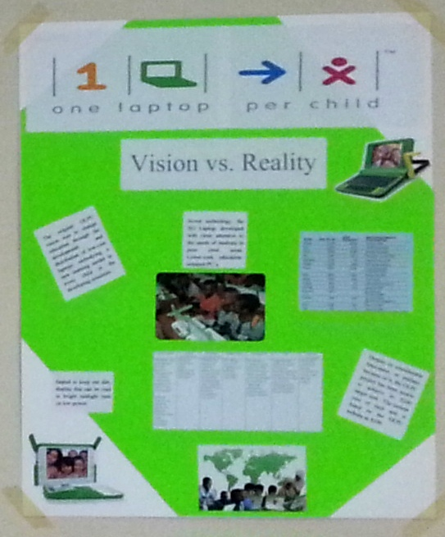

Slide 21
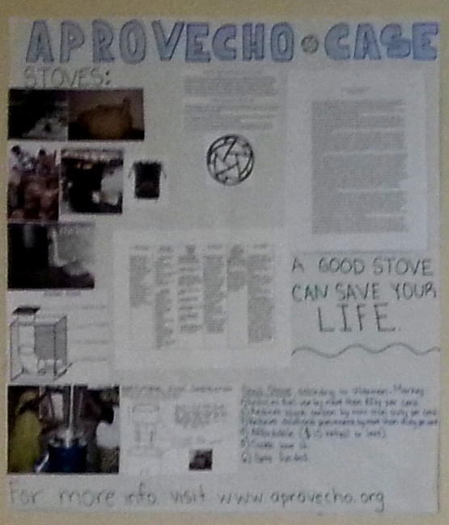

Slide 22
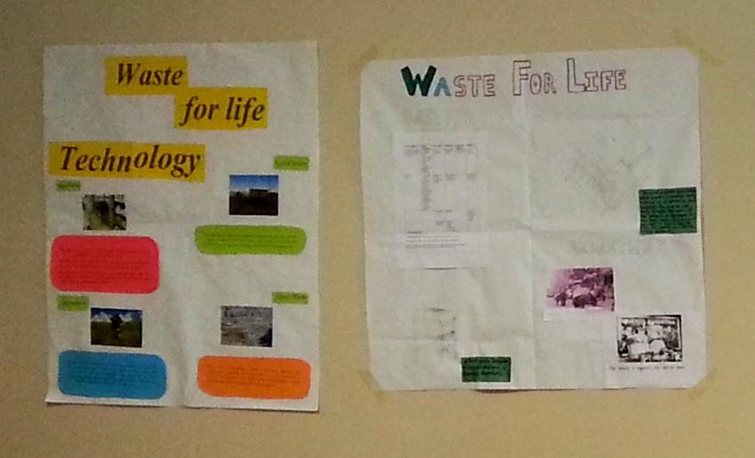

Slide 23
Responsible Technological Choice
AT Case | Pivot to PR | Frameworks
One Laptop Per Child | Laptops to Teachers | Restore / Preserve interpretive flexibility Labor Intensive Simple De-centralized
Removing gender bias from airplane cockpit design | Removing social injustice from gas pipeline design
Uchangi Dam (eng as honest broker) | Engineers as Honest Brokers in PR Energy Debates
Amish (exercise of technological choice) | Vieques—Are windmills an appropriate or intermediate technology for Vieques? | Values in technology “fit” those embedded in STS
Aprovecho Case (NGO designs and tests wood-burning cooking stoves) | Are wood-burning stoves an appropriate technology? Is there a need for these stoves in PR? Would PR be a good regional center for testing stoves? | Technology serves as “conversion factor” in the conversion of capabilities into functionings
Waste for Life (Press that makes building materials out of waste products) | Using STS analysis to explain difference between Lesotho success and Buenos Aires failure

Slide 24

Using non-traditional careers to identify
key global
Engineering skills

Slide 25
Job skills tie into response to relevance
Armando Borja from Jesuit Relief Services
A need for professional and occupational skills
Information Systems
Political Management
Leading without imposing
Problem-Solving
Conflict mediator
Consensus building

Slide 26
Job skills tie into response to relevance
Mike Hatfield from Aprovecho Research Center
Philosopher by training
Honing in on moral relevance:
respiratory illness major cause of death of children under five in developing nations
but not accepted until tied by Waxman-Markey to deforestation
Responding to relevance: integrating technical and moral expertise
Designing, testing, and distributing stoves
Working at Aprovecho Stove Camps

Slide 27
Waxman-Markey Goals
“Reduce fuel use by more than fifty per cent.
Reduce black carbon by more than sixty per cent.
Reduce childhood pneumonia by more than thirty per cent.
Affordable ($10 or less).
Cooks love it.”
Bilger, B. 2009. “Hearth Surgery: the quest for a stove that can save the world. The New Yorker Magazine, December 21, 2009: 88

Slide 28
Job skills tie into response to relevance
Inverse Peace Corps (Aprovecho)
Ianto Evans: “We wanted to work as an inverse Peace Corps…We would bring in villagers from Kenya or Lesotho, have them stay with us, and teach us what they knew—everything from cooking to growing things to assessing how much is too much.”
Bilger, B. 2009. “Hearth Surgery: the quest for a stove that can save the world. The New Yorker Magazine, December 21, 2009: 88

Slide 29
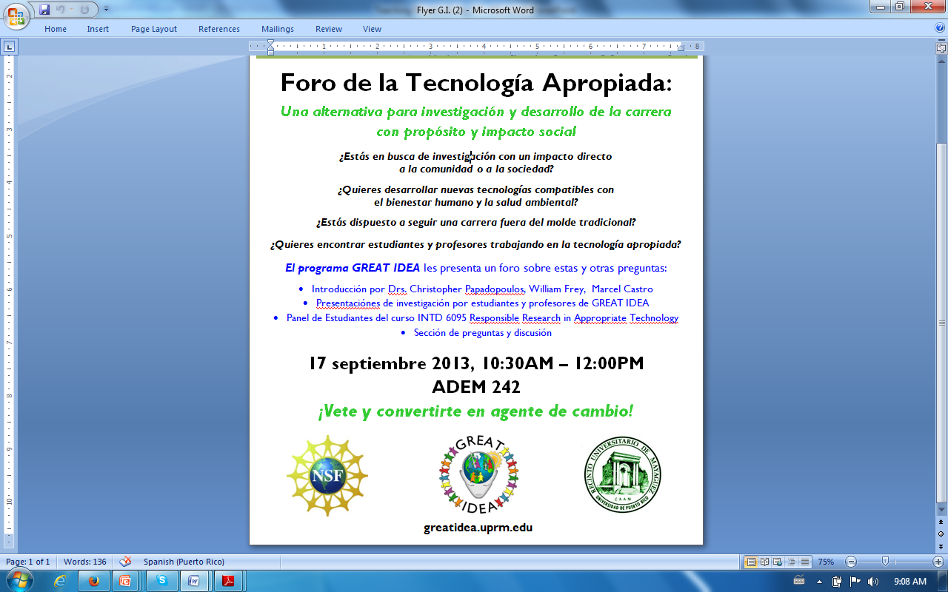

Slide 30
Alternative Job Fair
Are you satisfied with opportunities presented at current job fair?
What do you consider essential to a meaningful and fulfilling career?
What, for you, is an “auto-telic” experience?

Slide 31
Survey
Why did you choose your area of academic concentration?
What do you know about (and do you agree with) the “triple bottom line”
Expanding the scope of responsibility beyond profitability to include adding social and environmental value

Slide 32
Two Courses, one graduate, the other undergraduate
The Environments of the Organization, ADMI 4016
Responsible Choice in Appropriate Technology module
Poster Session: case in technological choice
Responsible Research in (Community Development) and Appropriate Technology INTD 6095 (Sponsored by GREAT IDEA)
Graduate course to explore research ethics issues in service learning

Slide 33
Graduates working with undergraduates
Undergraduates interview Graduates on their Appropriate Technology projects
Group studies Biosand Filters
Graduate students teach their research in Appropriate Technology
Present in AT Forum; answer questions; comment on posters
Undergraduate students study Appropriate Technology one of several business environments

Slide 34
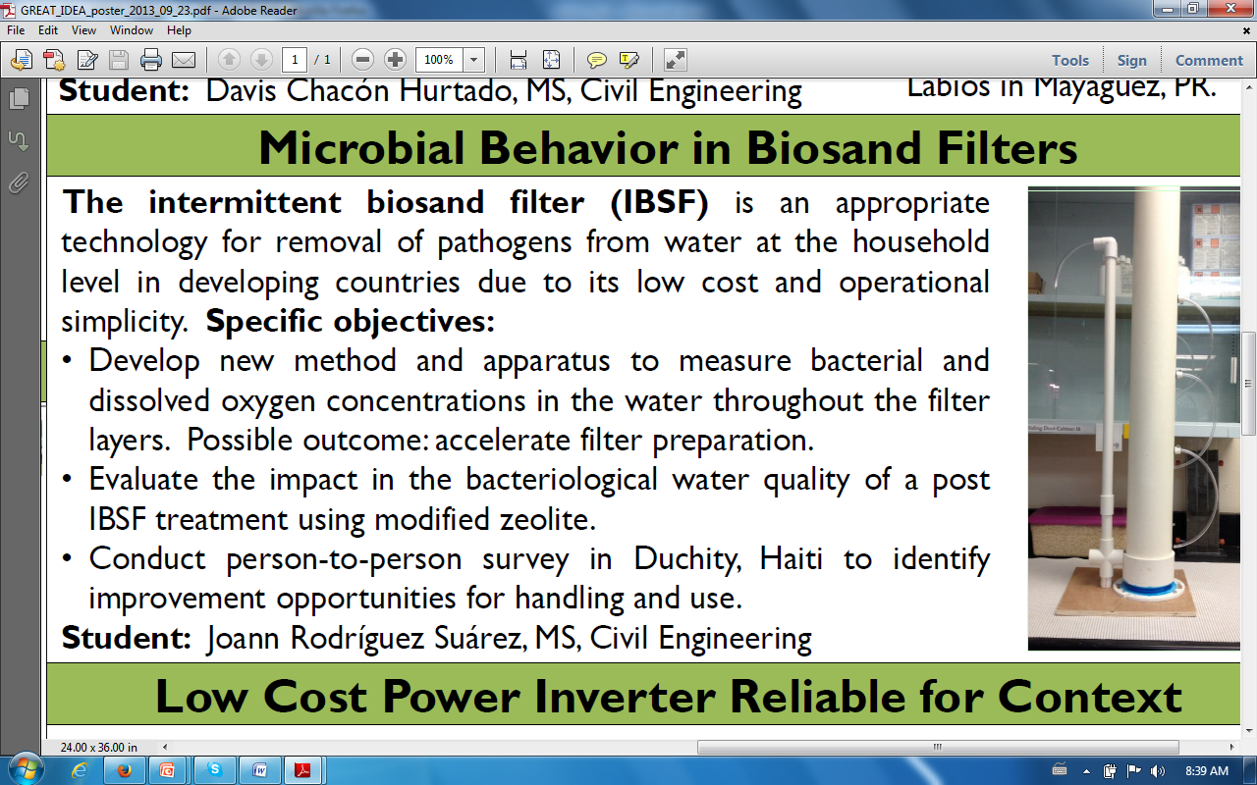

Slide 35
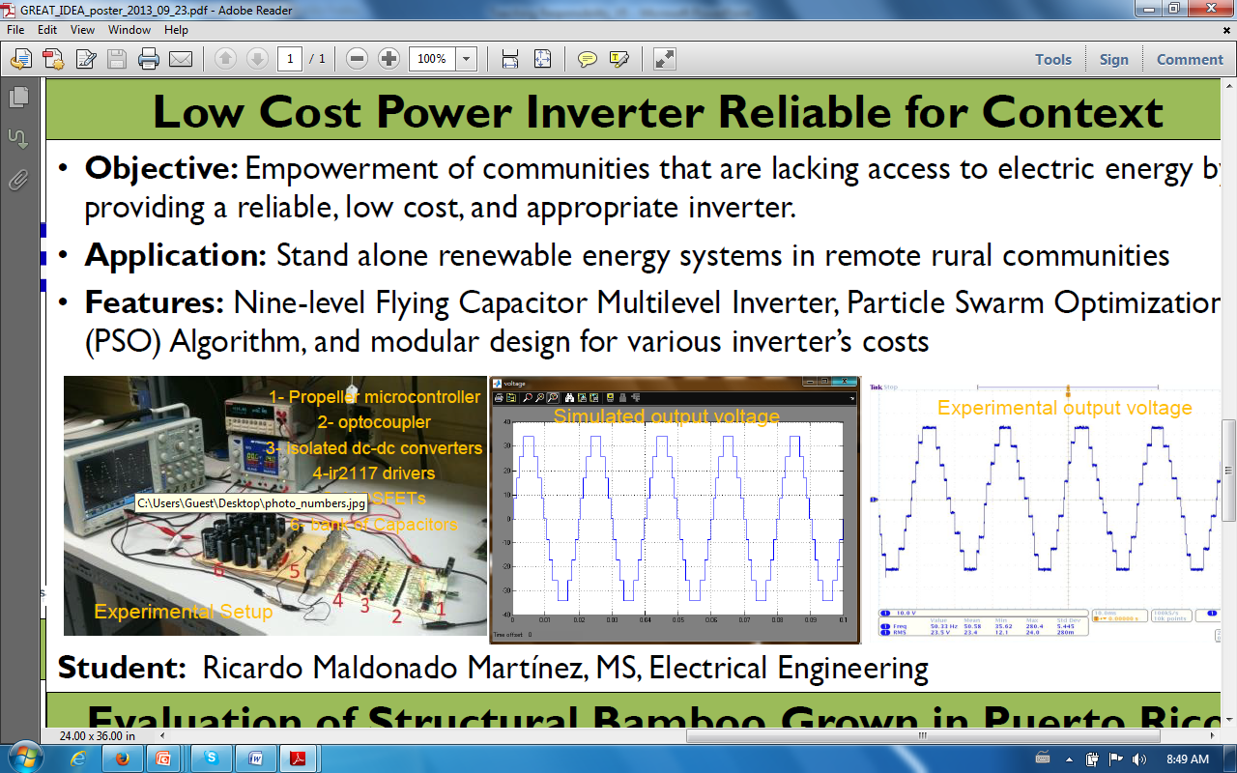

Slide 36
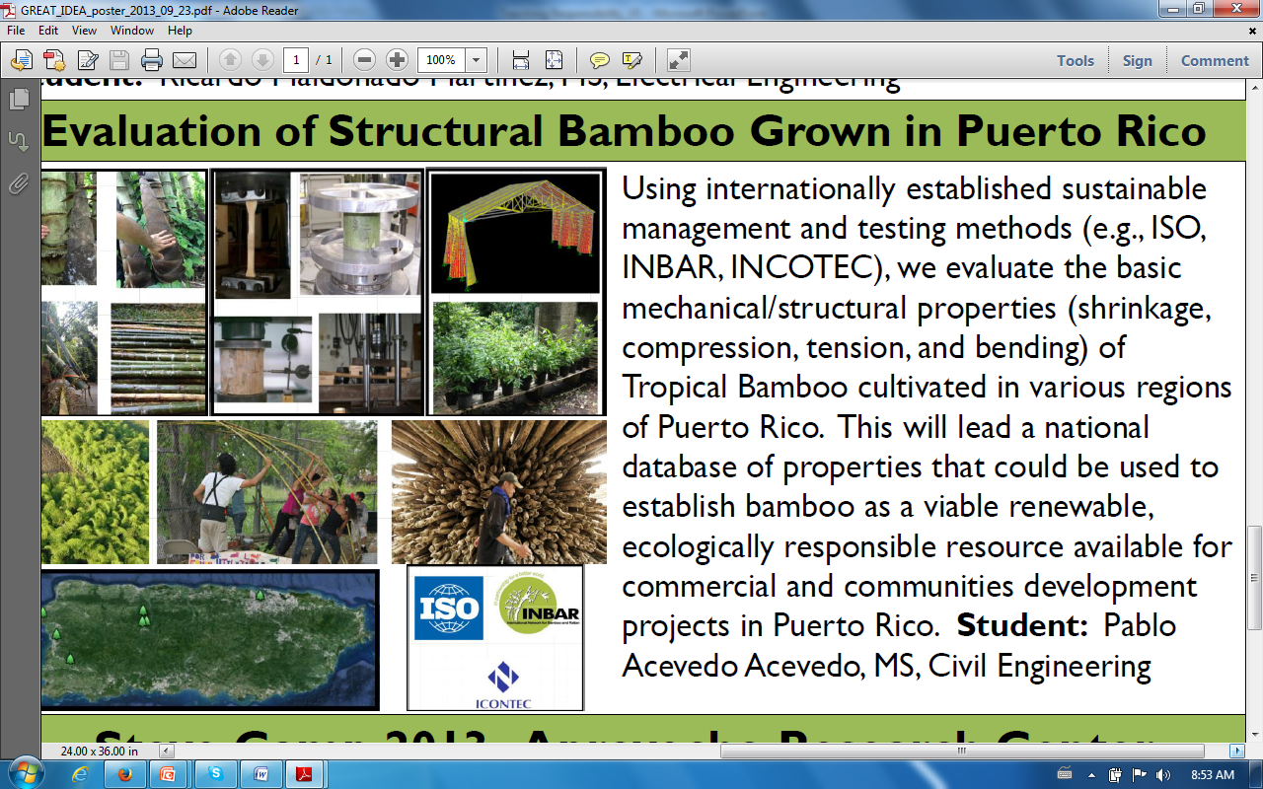

Slide 37
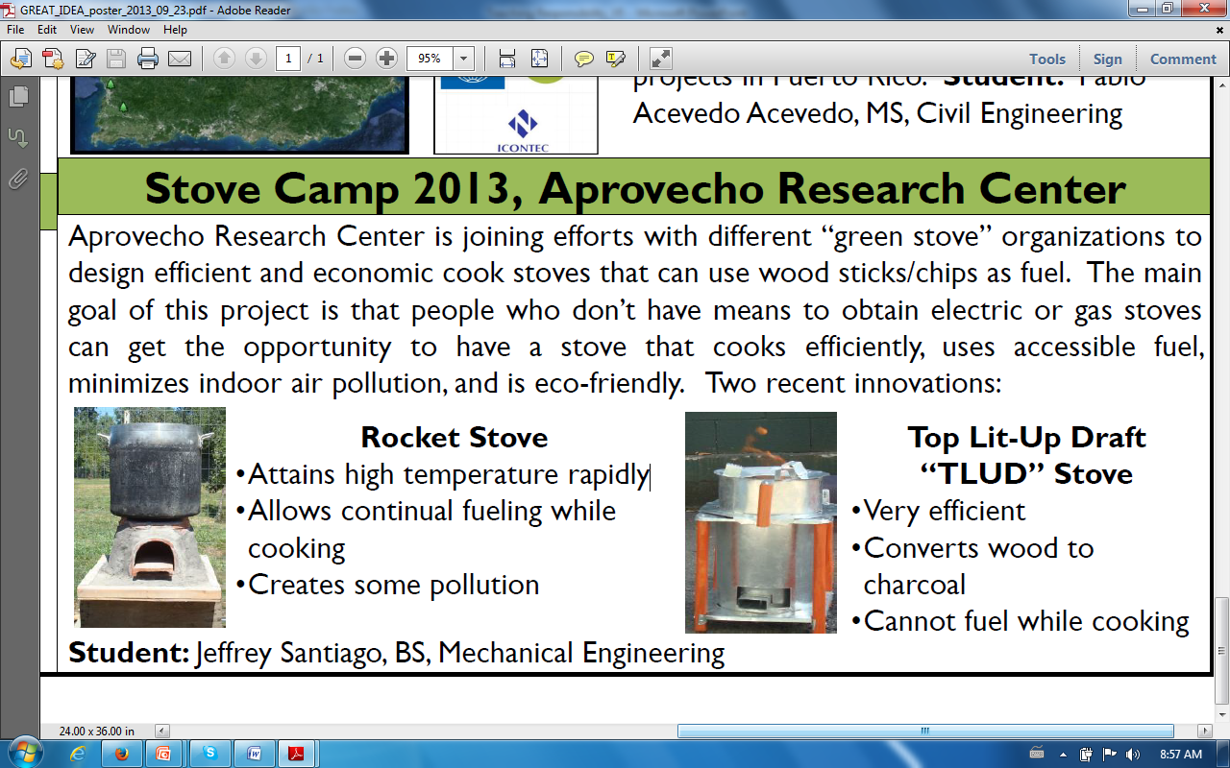

Slide 38
Thank-you
williamjoseph.frey@upr.edu
Connexions Courses
Responsible Research in Appropriate Technology
http://cnx.org/content/col11556/latest/
The Environments of the Organization
http://cnx.org/content/col11447/latest/
Capability Approach
http://cnx.org/content/m47654/latest/
Responsible Choice for Appropriate Technology
http://cnx.org.content/43922/latest/

Slide 39
Thanks to…
Chris Papadopoulos, PI of GREAT IDEA
Marcel Castro, Co-PI of GREAT IDEA
Jose Cruz, PI of EAC Toolkit Grant
UPRM ADEM for sponsoring this trip (Ana Martin, Interim Dean)
Special thanks to Cristina Rivera, Graduate Assistant for GREAT IDEA, who organized the Alternative Job Fair and the Forum on Appropriate Technology

Slide 40
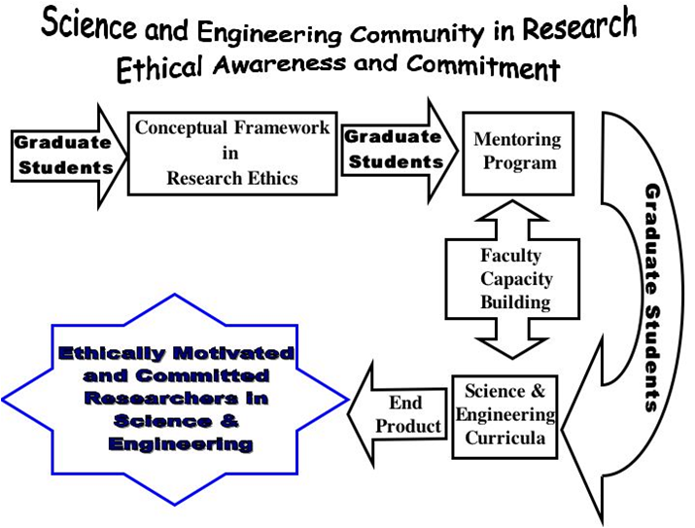
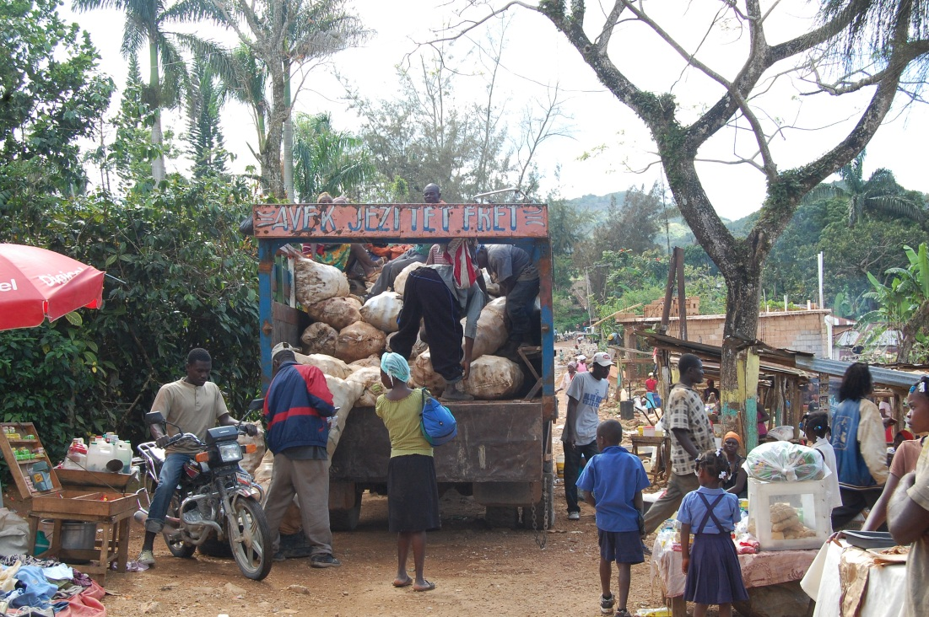

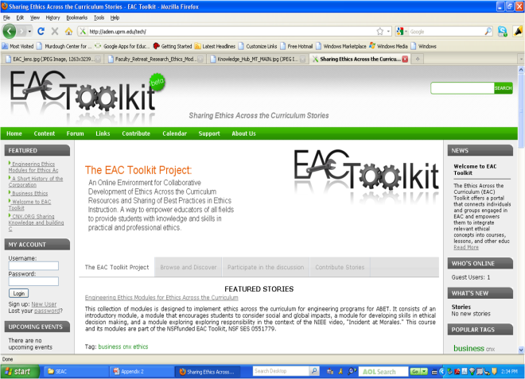

Thank-You
William J. Frey, College of Business Administration, University of Puerto Rico at Mayaguez
Moral Imagination
Realizing capabilities
Understanding Moral Expertise
Developing profitable partnerships
to alleviate poverty

